Slide 1

Generative Adversarial Networks (GANs)
From Ian Goodfellow et al.
Group H:
Hao Bai
Thomas Robert Bailey
Hafiz Bilal Ahmed
Goncalo Gil Chaves Figueira

Slide 2
GANs
Latent code
Asymptotically consistent
No Markov chains needs
Often regarded as producing the best samples
No good way to quantify this

Slide 3

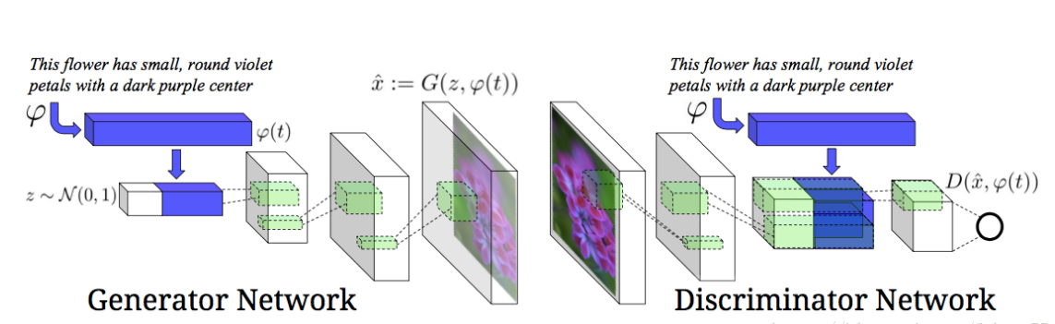
Architecture GANs

Slide 4
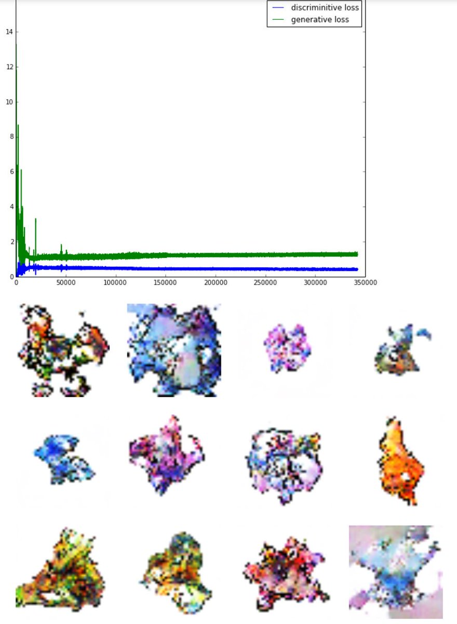
PokémonGAN
https://github.com/Zhenye-Na/pokemon-gan
Notes:
1. An interesting application of the generative pokemon, the left picture is after 1550 Epochs result
The blue line is discriminative loss
The green line is the generative loss.

Slide 5

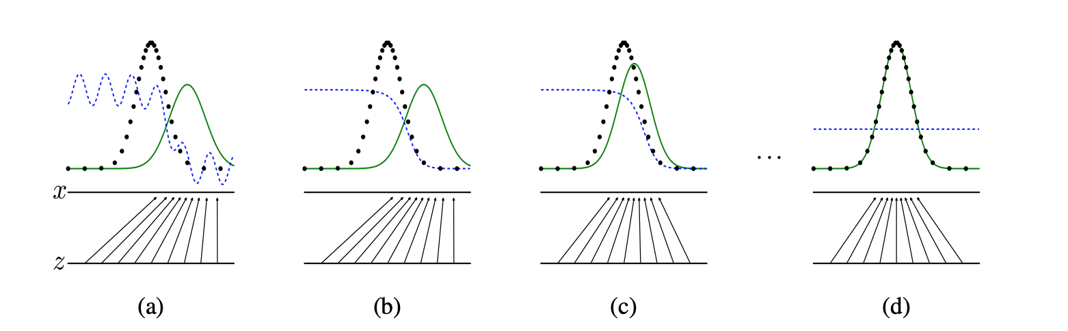
GANs
Discriminator: Training D to maximize the its rewards get from value function: V (G, D)
Generator: Training G to minimize the log(1 − D(G(z))), in other words Generator is trying to minimize Discriminator’s reward (or maximize its loss)
The Nash equilibrium:
Pg(x)= Pdata(x)
D(x) = 1/2
Notes:
After several steps of training, if G and D have enough capacity, they will reach a point at which both cannot improve because pg = pdata. The discriminator is unable to differentiate between the two distributions, i.e. D(x) = 1/2 .

Slide 6
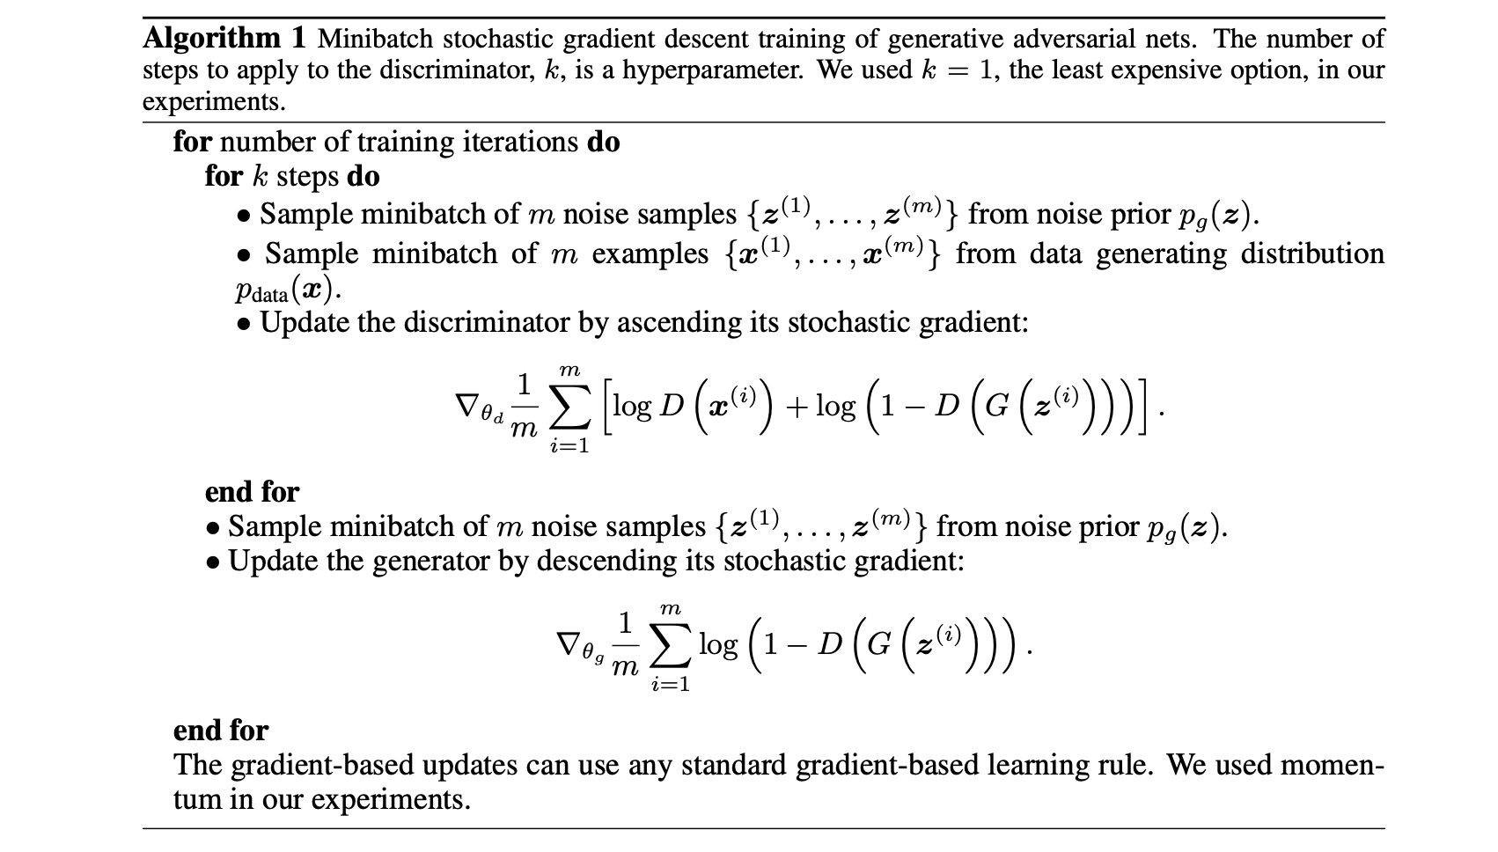
Discriminator updates
Generator updates
Global Optimality of Pg = Pdata

Slide 7
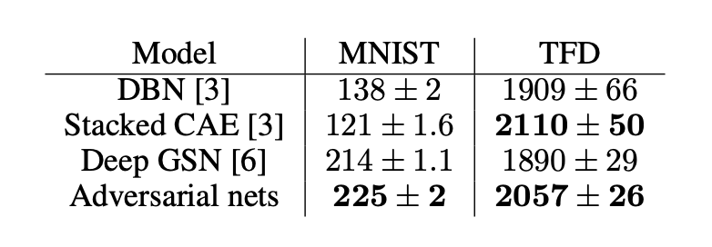
Experiments
Training data set:
MNIST
Toronto Face Database (TFD)
CIFAR-10
Estimating the likelihood:
Not perform well in high dimensional spaces
Somewhat high variance
Can sample but not estimate likelihood directly
Notes:
Training dataset :
The generator nets used a mixture of rectifier linear activations and sigmoid activations
The discriminator net used maxout activations,
Limitation:
###################

Slide 8
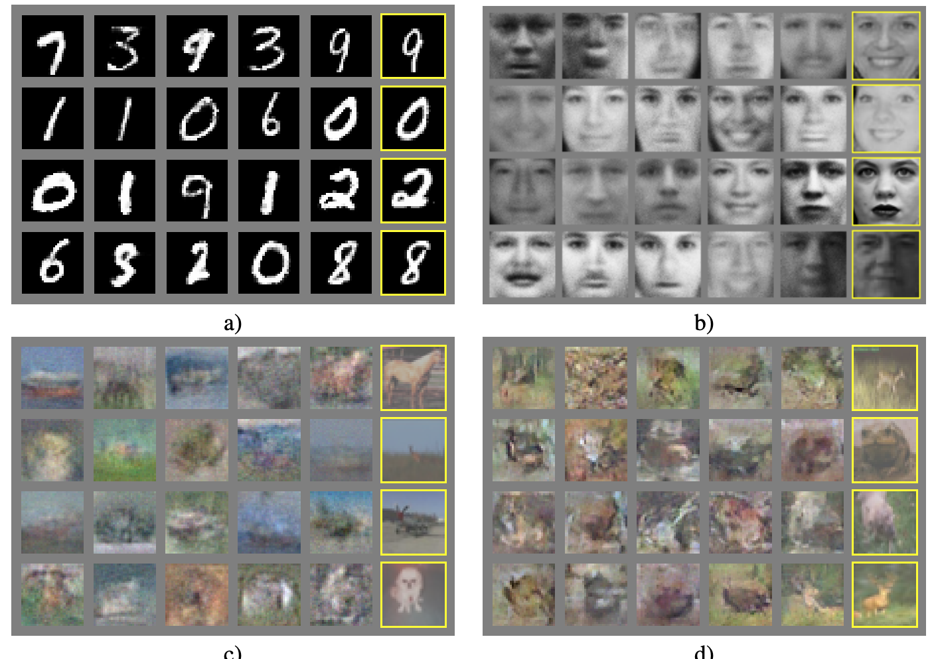
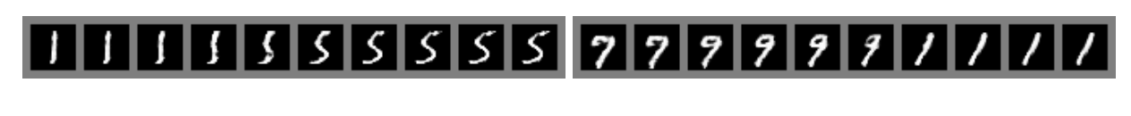
Experiments
No claim that these samples are better than samples generated by existing methods
Highlight the potential of the adversarial framework
MNIST
TFD
CIFAR-10 (fully connected model)
CIFAR-10 (convolutional discriminator and “deconvolutional” generator)
Notes:
MNIST
TFD
CIFAR-10 (fully connected model)
CIFAR-10 (convolutional discriminator and “deconvolutional” generator)
Potential: ########################

Slide 9
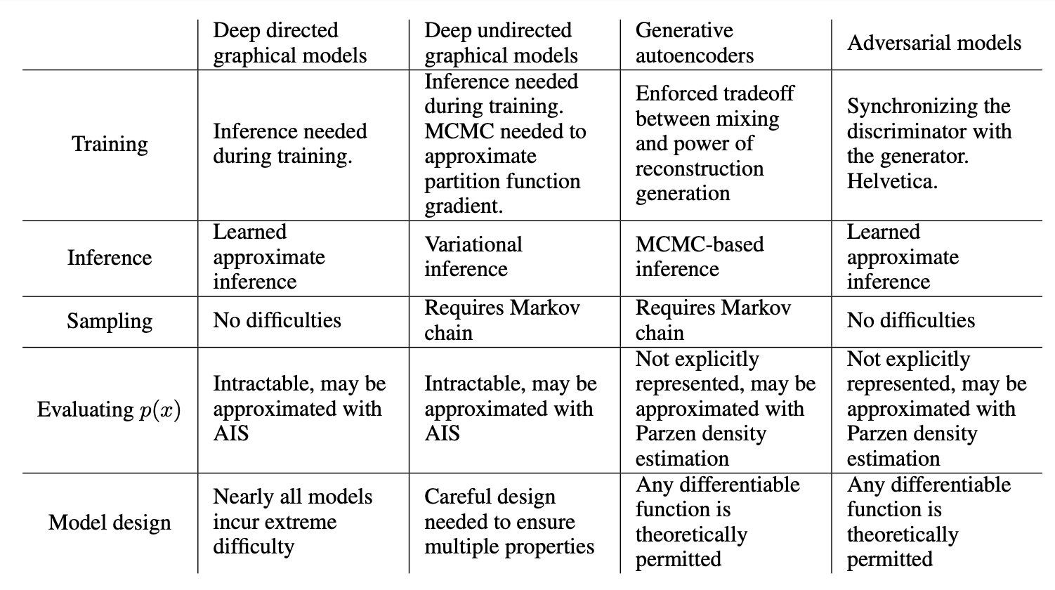
Comparison
Notes:
comparison of generative adversarial nets with other generative modeling

Slide 10
Summary
GANs are generative models that are implemented using two stochastic neural network modules: Generator and Discriminator.
State-of-art
Limitation(to the disadv and put here is future work)
Generator fails to output diverse samples
Training could be accelerated
By divising better methods for coordinating G and D
Determining better distributions to sample z from during training
Notes:
training could be accelerated greatly by divising better methods for coordinating G and D or determining better distributions to sample z from during training.
Advantage
No Markov chains
Only backprop is used to obtain gradients
No inference is needed during learning
Wide variety of functions can be incorporated into the model.
Disadvantages
No explicit representation of Pg(x), and that Discriminator must be synchronized well with Generator during training

Slide 11
Contributions
Slides : Hao Bai (25%, speaker for 2nd part), Thomas Robert Bailey (25%, speaker for 1st part)
Presentation : Hafiz Bilal Ahmed (25%, slides for 1st part), Goncalo Gil Chaves Figueira (25%, slides for 2nd part)
As a group, we refined the slides and the presentation itself.

